Slide 1
Plan My Move
Workshop
Barksdale Military & Family Readiness Center
Relocation Assistance Program
⚜ Fight’s On ⚜

Slide 2
Pinning Down PCS Success
Click to Watch

Slide 3
OVERVIEW
MFRC Resources
Childcare Assistance
Financial Entitlements
School Liaison
TRICARE
Additional PCSing Tips/Resources
To include Pets and Overseas Moves
Personal Property/JPPSO /Claims

Slide 4
Military Family Life Counselor Program
Adult and youth services available
Call 318-456-8400 opt 9
Click here to learn more about the MFLC program

Slide 5
Mandatory Financial Readiness PCS
touchpoint training available via
MyVector or at the Military & Family Readiness Center
For more information, call 318-456-8400, opt 3
5

Slide 6
Employment Assistance Program
The Employment Assistance Program assists Active Duty, Reserve/Guard, Military Spouses/Dependents, Retirees, and DoD Civilians achieve short and long-term employment goals.
Seek out education/training opportunities
Provide information on Licensure Re-Certification Re-imbursement
Provide research resources for local employment opportunities in the civilian and federal work places
Conduct resume review (M&FRC does NOT write resumes)
Encouraging attendance at employment workshops
Networking
For more information, call 318-456-8400, opt 7

Slide 7
The scholarship provides up to $4,000 in financial assistance for spouses pursuing
Associate degrees
Occupational certificates
Licenses in portable career fields
MYCAA Scholarship

Slide 8
Spouse Reimbursement for Licensure/Certification
Reimbursement up to $1000 for occupational state relicensing/recertification costs due to PCS/PCA for orders
For more information, call 318-456-8400, opt 7

Slide 9
Exceptional Family Member Program (EFMP)
To reach the Barksdale AFB Military and Family Readiness Center Exceptional Family Member Program team for additional assistance or questions, please call
318-456-2658

Slide 10
Voting Assistance Program
Your Installation Voter Assistance Office Is Here To Help!
Register to Vote
Request Absentee Ballots
Notifications for Change of Address
Forms Available
Federal Post Card Application (FPCA)
Used to register to vote (automatically requests absentee ballot)
Federal Write-In Absentee Ballot (FWAB)
In case you have not yet received your absentee ballot from your state
Visit www.fvap.gov for assistance
Or contact us at vote@barksdale.af.mil or call 318-456-8400!

Slide 11
Childcare Assistance
Apply for on-base childcare spaces at the Child Development Center and/or Family Childcare Providers via militarychildcare.com

Slide 12
Childcare for PCS Program
Air Force Aid Society
Active, Air National Guard, Reserve (Title 10, USC for 15+ days)
20 hours of childcare per child within 60 days of departure/60 days after arrival
Gaining & Losing Base (contact M&FRC at respective bases)

Slide 13
BARKSDALE AFB FINANCE
⚜ Fight’s On ⚜

Slide 14
Overview
Government Travel Card (GTC)
PCS Entitlements
Dislocation Allowance (DLA)
Temporary Lodging Expense (TLE)
Temporary Lodging Allowance (TLA)
Common Questions/Issues
Questions/Assistance
⚜ Fight’s On ⚜

Slide 15
Government Travel Card (GTC)
Use to pay for authorized travel expenses
Common authorized expenses: airfare, lodging, gas, food, rental truck (U- Haul)
Keep receipts for reimbursement purposes.
Monitor your GTC! In the end you are still liable and responsible for it.
Split disbursement is available while filing the 1351-2 at your NPDS Finance.
⚜ Fight’s On ⚜

Slide 16
PCS Entitlements – Per Diem
When utilizing POV, the authorized reimbursement for members and/or dependents is monetary allowance in-lieu of transportation (MALT) Plus
MALT Plus is mileage + per diem
Standard CONUS Per Diem Rate ($166/day)
Official distance is calculated using the Defense Table of Official Distances between authorized points of travel
⚜ Fight’s On ⚜

Slide 17
PCS Entitlements – Per Diem (Cont.)
When utilizing transportation by commercial air, the authorized allowance for members is a cost reimbursement not to exceed (NTE) the constructed cost (TR cost)
Per diem is calculated at 75% of the locality rate of the new permanent duty station (NPDS)
Member (and dependents, if applicable) is authorized 1 travel day
⚜ Fight’s On ⚜

Slide 18
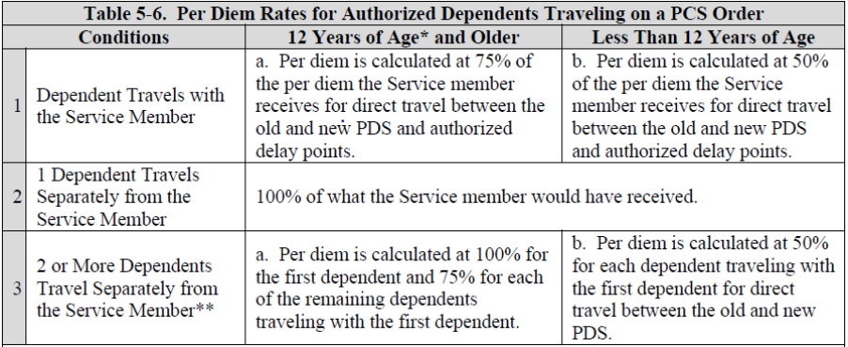
PCS Entitlements – Per Diem (Cont.)
⚜ Fight’s On ⚜

Slide 19
PCS Entitlements – POV Mileage
POV mileage is based upon the official distance between the old and new duty station
$0.21 per mile
Payable for up to 2 vehicles
Must have dependent of driving age drives the second vehicle
⚜ Fight’s On ⚜

Slide 20
Dislocation Allowance (DLA)
DLA partially reimburses a Service member for expenses incurred in moving a household
Not entitled if moving into unaccompanied government housing (dorm)
Generally, only one DLA is permitted in a fiscal year.
DLA is a flat rate based on rank and dependency status.
Dependents must relocate in order to receive the With-Dependent Rate.
Mil-to-Mil couples are only authorized one DLA when sharing the same residence at the old duty location and new duty location.
⚜ Fight’s On ⚜

Slide 21
Dislocation Allowance (DLA) (Enlisted)
⚜ Fight’s On ⚜

Slide 22
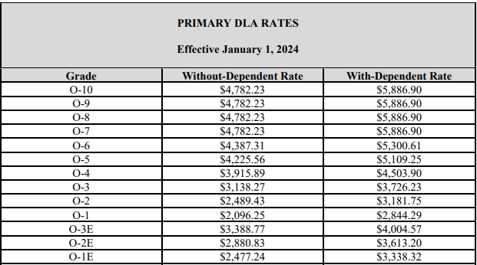
Dislocation Allowance (DLA) (Officer)
⚜ Fight’s On ⚜

Slide 23
Temporary Lodging Expense (TLE)
TLE is designed to partially reimburse a Service member for lodging and meals while occupying temporary lodging in the CONUS.
Receipts are required for reimbursement.
Non-availability letter is required to reimburse off-base lodging.
If no Non-A is provided, member will be limited to the on-base government lodging rate for reimbursement.
CONUS to CONUS PCS:
TLE is limited to 14 days max.
14 days can be split between Old Permanent Duty Station (OPDS) or New Permanent Duty Station (NPDS)
ex: 7 days at OPDS, 7 days at NPDS/ 10 days OPDS, 4 days NPDS/ all 14 days at NPDS/ etc.
CONUS to OCONUS PCS:
TLE is limited to 7 days CONUS.
Member may be entitled to TLA once OCONUS.
⚜ Fight’s On ⚜

Slide 24
Temporary Lodging Allowance (TLA)
TLA is intended to partially reimburse Service members for higher than normal expenses incurred while occupying temporary lodging OCONUS.
TLA must be filed through OCONUS Housing Management Office (HMO).
The TLA Authority (usually delegated to the HMO) will determine the number of days authorized
Standard limitation ranges between 3-30 days.
TLA ends if the Service member fails to accept adequate permanent Government quarters or stops diligently searching for permanent private-sector housing.
TLA is considered a military pay entitlement not a travel pay entitlement.
This means TLA will pay out in a paycheck and CANNOT be split-disbursed to your GTC card!
For more specific information on TLA, please contact your gaining HMO/base. They will be able to give you the most up-to-date information for your area.
⚜ Fight’s On ⚜

Slide 25
Common Questions/Issues
Baggage Fees:
Baggage Fees are only reimbursable for the first to checked bags (per person) not to exceed 70 pounds each. Excess baggage is NOT reimbursable.
Most U.S. carriers authorize more 4-5 checked bags for free. (You may need to show your military ID or PCS orders)
CONUS to CONUS: Shipping a second vehicle.
Shipment of a second vehicle may be authorized reimbursement not to exceed the MALT between authorized points. This must be authorized on your orders.
Flying Commercial Air to OCONUS Location:
Unless authorized on your orders, you MUST book your overseas travel through TMO and MUST utilize a U.S. based carrier.
⚜ Fight’s On ⚜

Slide 26
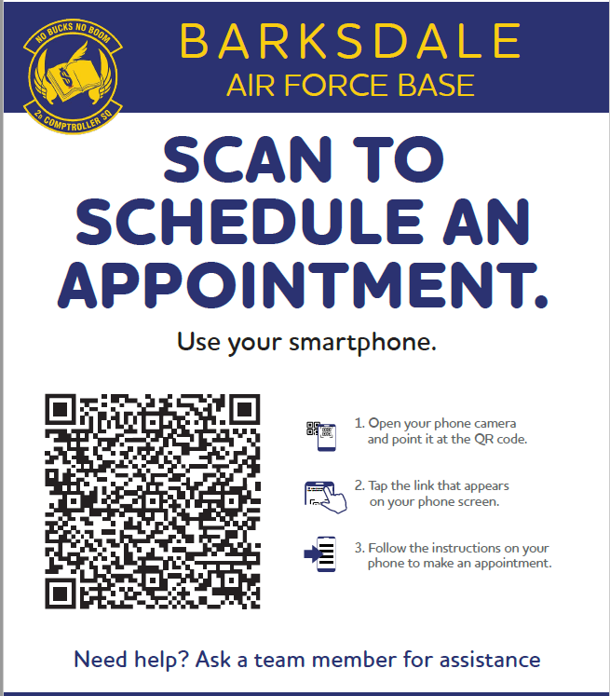
Questions/Assistance
Finance Customer Service
Monday: 0900 - 1500
Tuesday: By appointment
Wednesday: CLOSED for customer pay process
Thursday: By appointment
Friday: By appointment
CLOSED on all holidays and Wing Training/Down days.
Comptroller Service Portal (CSP)
**This is the best way to communicate with Finance**
https://csp.cce.af.mil/#/
⚜ Fight’s On ⚜

Slide 27
Planning Your PCS Move
Barksdale AFB - Traffic Management Office
If you have any questions please contact our office at 456-3229

Slide 28
Overview
Step 1: Receiving assignment notification Step 2: Passenger Movement
Step 3: Receiving your orders
Step 4: Create your shipment
PPM
Government Contracted Move
POV
Closing Comments from TMO
**Keep in mind, timeline varies from member to member**
If you have any questions please contact our office at 456-3229

Slide 29
Step 1: Assignment Notification
You will be provided an official assignment notification.
NOTE: Assignment notification does not mean you have “orders.”
If you have any questions please contact our office at 456-3229

Slide 30
Step 1: Assignment Notification
Things you can do at this time:
Research housing options at your next location
https://installations.militaryonesource.mil/
Visit Military OneSource for moving resources.
Basic Information for Your Personal Property
Create/Update Defense Personal Property System profile.
If you have a profile already, this is a good opportunity to log back in and update rank, and contact information.
Contact TMO Passenger Travel section & make flight reservations (order is not required)
You CANNOT create shipment at this time because you do not possess an authorization.
If you have any questions please contact our office at 456-3229

Slide 31
Step 2: TMO – Passenger Movement
For flights, no orders necessary to initiate a reservation.
Fill out Flight Request provided by Passenger Travel Section.
Ensure your GTC is active!
For OCONUS travel:
Per DTR, Part I, Chapter 103, Order of Precedence, United States Transportation Command (USTRANSCOM)-contracted airlift (e.g., Patriot Express channel airlift, AMC) must be used for Outside the Continental United States (OCONUS) travel unless there is a documented negative critical mission impact. Even if it is more convenient for the traveler.
If you have any questions please contact our office at 456-3229

Slide 32
Step 2: TMO – Passenger Movement
Members are authorized 2 pets (cats or dogs) per family on AMC flight on 1st come - 1st serve basis! *See slides 51-54 for more information re: PCSing with pets*
The traveler is solely responsible for procuring, shipping, all the related costs, and restrictions for their pet on any non-AMC segmented flight.
We cannot fly you to or from your leave location. Ask about Circuitous Travel.
Passenger Travel Section
318-456-3189
2LRS.LGRDF.PassengerMovement@us.af.mil
If you have any questions please contact our office at 456-3229

Slide 33
Step 3: Receiving your orders
Your moving process begins!
FYI: No movement can be done WITHOUT ORDERS.
Review orders and ensure YOU understand your entitlements.
(Members should receive orders NET 120 day prior to member’s PDD from Barksdale AFB)
Verify everything is correct; basic info, destination, dependents, etc.
Create your shipment on DPS: PPM, HHG, NTS
https://dps.move.mil/cust/standard/user/home.xhtml
Contact our office if you have any questions in this portion.
If you have any questions please contact our office at 456-3229

Slide 34
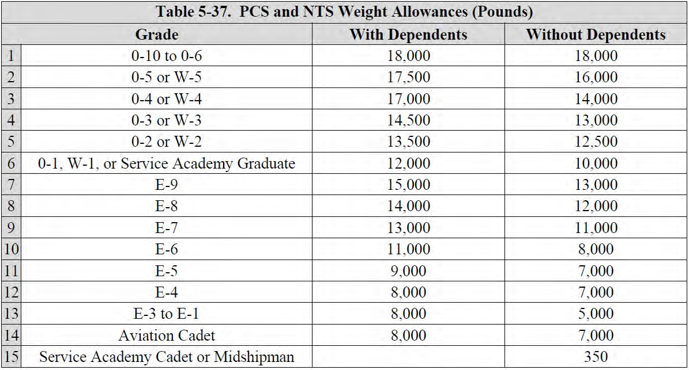
Step 4: Types of Shipments (Weight Entitlement)
Joint Travel Regulation, Table 5-37
If you have any questions please contact our office at 456-3229

Slide 35
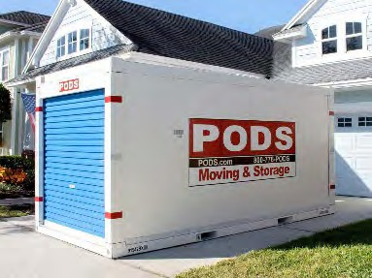
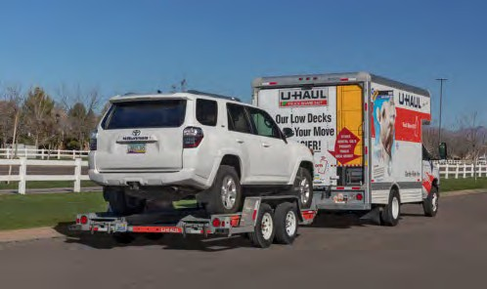
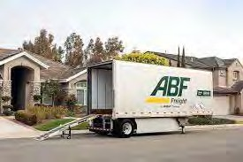
Step 4: Type of Shipments: Personal Procured Movement (PPM)
Please visit the follow link for local moving agents: Local Moving Agents
*Not all local agents are contracted/endorsed by the government.
PODS – Container delivered to your location, flexibility to take your time packing and loading. Driver picks up container and delivers to next destination.
Service: Online
Phone Number: (877)770-7637 Website: pods.com
UHAUL Rent truck/trailer
Bossier Location
Service: In Person/Online Phone Number: 318-5504167 Address: 2205 Barksdale Blvd, Bossier City, LA 71112
Hours: Mon-Fri 10AM-3PM
Shreveport Location
Service: In Person/Online Phone Number: 318-861-1140
Address: 1050 Shreveport Barksdale Hwy Shreveport, LA 71105
Hours: Mon-Fri 7AM-4:30PM
UPack – similar to PODS.
Container will be dropped off at location and picked up by driver.
Service: Online
Phone Number: 888-571-7422
Website: upack.com
If you have any questions please contact our office at 456-3229

Slide 36
Step 4: Type of Shipments: Government Contracted Move
Member is authorized either Household Goods (HHGs), Unaccompanied Baggage (UB) and/or Non-Temporary Storage (NTS).
During your TMO briefing, you will sign documentation required to book your shipment.
TMO will submit your shipment to Joint Personal Property Shipping Office in San Antonio, Texas for your shipment to be assigned a Transportation Service Provider (TPS).
If you have any questions please contact our office at 456-3229

Slide 37
Step 4: Type of Shipments: Government Contracted Move
Once your TSP is assigned, you will be contacted to confirm your dates DPS and schedule a pre-move survey, if required.
REMEMBER! Dates between the TSP and the member are NEGOTIABLE!!!
Good communication with your TSP is imperative to ensure a smooth move. Your TSP is responsible for your move from start to finish, and will assign a move coordinator to be your focal point to discuss date/address changes, arranging delivery, etc.
If you have any questions please contact our office at 456-3229

Slide 38
Step 4: Type of Shipments: Government Contracted Move
HHGs defined as are items associated with the home and personal effects belonging to a Service member or civilian employee and dependents on the effective date of the order or transfer. A Service member's or civilian employee’s HHG may only include items that are legally accepted and transported by an authorized commercial HHG transporter.
If you have any questions please contact our office at 456-3229

Slide 39
Step 4: Type of Shipments: Government Contracted Move
UB defined as items shipped by an expedited mode to a TDY or PCS location unaccompanied baggage includes personal clothing and effects, equipment directly related to the assignment, essential cooking items, light housekeeping items, cribs, playpens, and baby carriages that are required for the care of dependents. Items such as refrigerators, washing machines, and other major appliances or furniture are not unaccompanied baggage.
If you have any questions please contact our office at 456-3229

Slide 40
Step 4: Type of Shipments: Government Contracted Move
Transit Time
HHG traveling to overseas: ~45-60 days
UB traveling to overseas: ~30-45 days
HHG traveling within CONUS: ~5-15 days
If you have any questions please contact our office at 456-3229

Slide 41
Step 4: Type of Shipments Privately Own Vehicle (POV)
POV shipments CONUS are authorized for BLUEBARK, Wounded Warriors, or medical reasons w/letter from PCM/doctor.
Storage or shipping of POV to OCONUS, must be specified on orders. A letter from our office is required for shipment/storage prior to you dropping off your vehicle at the VPC.
Can be stored/shipped in ANY Government approved Vehicle Processing Centers (VPC)
Los Angeles, CA
Norfolk, VA
Seattle, WA
St. Louis, MO
San Diego, CA
Atlanta, GA
Baltimore, MD
Charleston, SC
Orlando, FL
Dallas, TX
If you have any questions please contact our office at 456-3229

Slide 42
Closing Comments from TMO
Communication is key
DO NOT WAIT!!! Once you receive orders, start your move ASAP!
Everything submitted through DPS is a request, until confirmed by Transportation Service Provider.
If you have specific questions/concerns, we are here to help
Learn more about your entitlements
Joint Travel Regulation (JTR)
AFI 24-602v4
If you have any questions please contact our office at 456-3229

Slide 43
Contact Information
For any further questions:
Barksdale AFB
Traffic Management Office
318-456-3229
2LRS.TMO.PersonalProperty@us.af.mil

Slide 44
School Liaison Program Barksdale AFB, LA
School Liaison Officer
Jacqueline Robertson
Office Hours: Monday – Friday 0730-1630
* Appointments Available Upon Request
Located at: Building # 4400 Col dePyssler MSG Bldg
Office Phone: (318) 456-4098
Cell Phone: (318) 564-9099
Email: BarksdaleSchoolLiaison@us.af.mil
⚜ Fight’s On ⚜

Slide 45
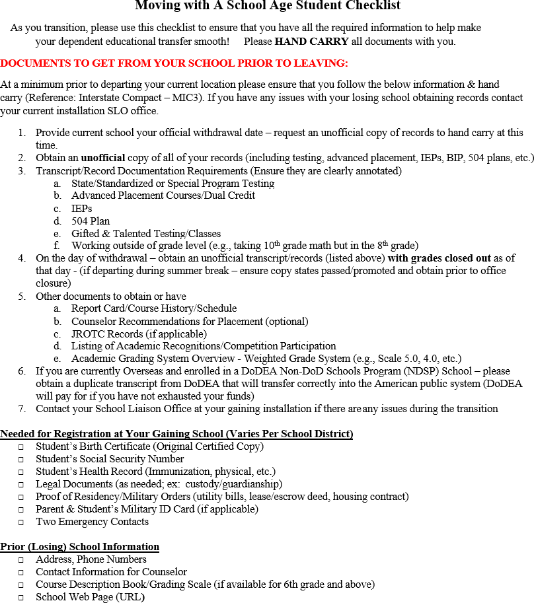
Barksdale AFB Child & Youth Education Services – School Liaison
S
t u d
C h e c k l i s t
n t

Slide 46
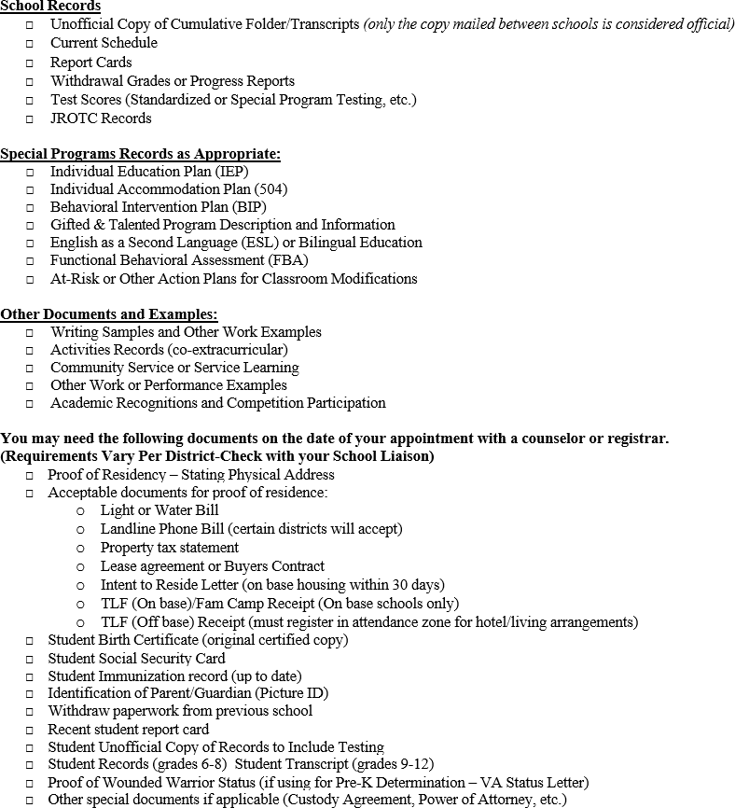
Barksdale AFB Child & Youth Education Services – School Liaison
S
t u d
C h e c k l i s t
n t

Slide 47
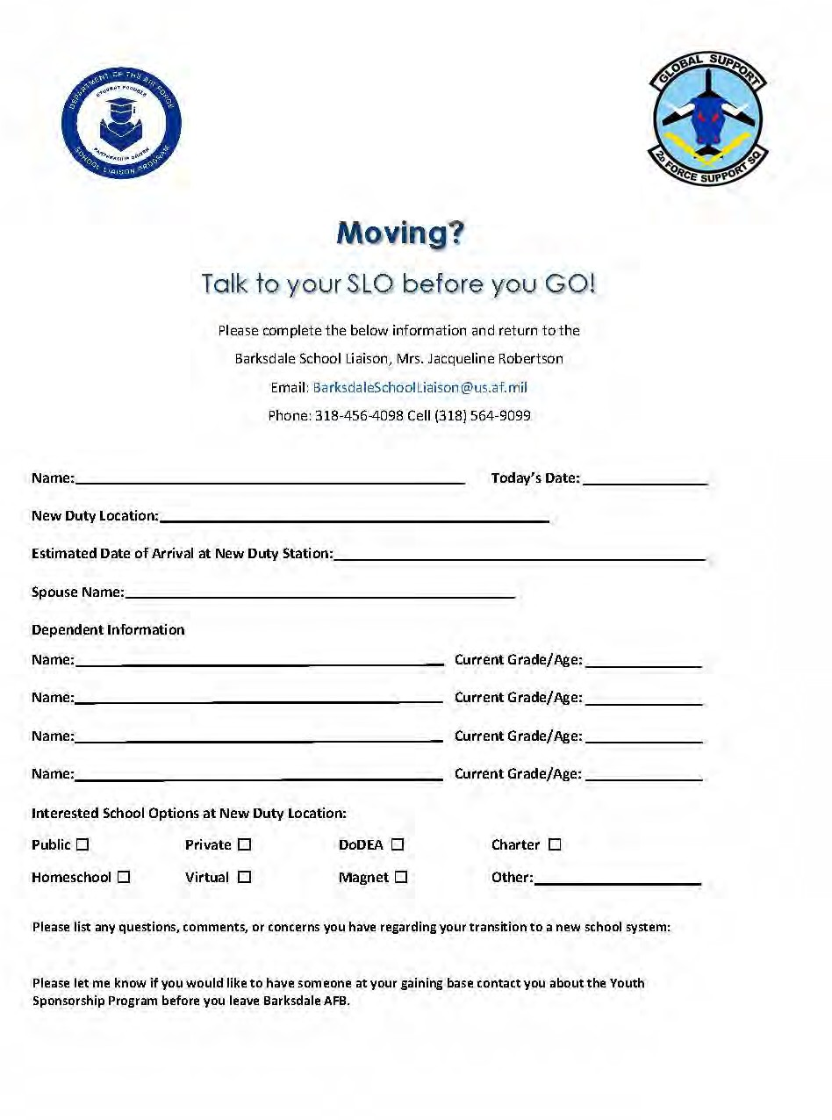
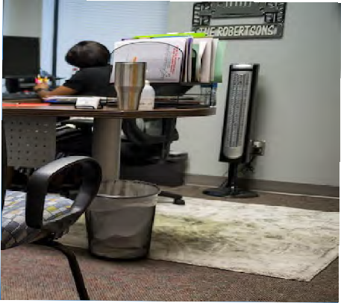
Student Focused
Partnership Driven

Slide 48
School Liaison Program Barksdale AFB, LA
Questions? Call
School Liaison Officer
Jacqueline Robertson
Office Phone: (318) 456-4098
Cell Phone: (318) 564-9099
Email: BarksdaleSchoolLiaison@us.af.mil
⚜ Fight’s On ⚜

Slide 49
TRICARE Prime enrollment is portable
Do not disenroll from TRICARE Prime before you move
Update personal information in DEERS, 2 options:
Beneficiary Web Enrollment Site or the DEERS Web site
Transfer Prime coverage within 30 days of arrival at new location
Phone, online (CONUS only), mail, or at TRICARE service center (OCONUS only)

Slide 50
For urgent, routine or specialty health care
Call Humana Military: 1-800-444-5445 to obtain nearest urgent care information and then appointment line: 318-456-6555
For emergencies, go the nearest hospital emergency room or call 911
MUST notify your PCM or regional contractor within 24 hours, or the next business day, so that ongoing care can be coordinated and to ensure you receive proper authorization for care.

Slide 51
Questions ???
Health Benefits Advisor
318-456-6405
Humana Military
1-800-444-5445

Slide 52
Additional PSCing Tips/Resources

Slide 53
Pets
Update shot records within 1 year of travel
Check airline restrictions
Check country/base breed restrictions
Check quarantine and detention requirements
Call the BAFB Veterinary Clinic at 318-456-3923 to discuss steps on how to obtain a health certificate within 5 days of travel
NOTE: ao Nov 2023, the BAFB Vet Clinic does not have a Vet, therefore the above health certificate needs to be obtained elsewhere

Slide 54
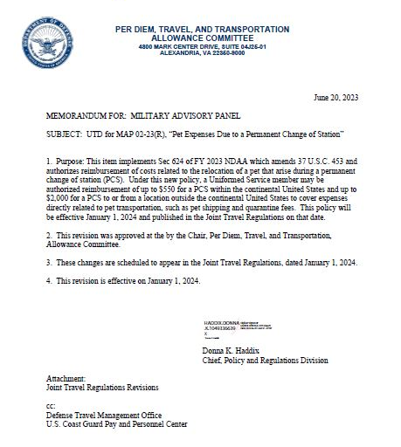
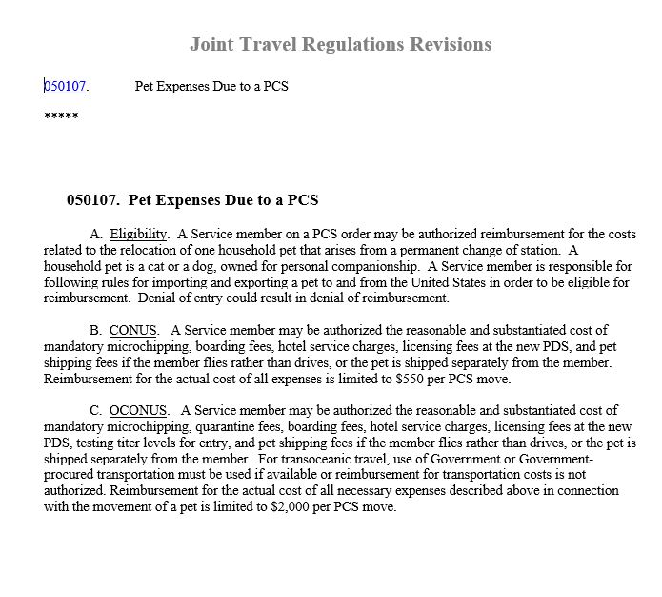
PCS Pet Policy Effective Jan 1 2024

Slide 55
PCS Pet Policy Effective Jan 1 2024 Cont.
2. CONUS. A Service member may be authorized the reasonable and substantiated cost of mandatory microchipping, boarding fees, hotel service charges, licensing fees at the new PDS, and pet shipping fees if the member flies rather than drives, or the pet is shipped separately from the member. Reimbursement for the actual cost of all expenses is limited to $550 per PCS move.
3. OCONUS. A Service member may be authorized the reasonable and substantiated cost of mandatory microchipping, quarantine fees, boarding fees, hotel service charges, licensing fees at the new PDS, testing titer levels for entry, and pet shipping fees if the member flies rather than drives, or the pet is shipped separately from the member. For transoceanic travel, use of Government or Government procured transportation must be used if available or reimbursement for transportation costs is not authorized. Reimbursement for the actual cost of all necessary expenses described above in connection with the movement of a pet is limited to $2,000 per PCS move.
Changes Effective 2024. On January 1, 2024, the following pet transportation allowances will apply:
1. Eligibility. A Service member on a PCS order may be authorized reimbursement for the costs related to the relocation of one household pet that arises from a permanent change of station. A household pet is a cat or a dog, owned for personal companionship. A Service member is responsible for following rules for importing and exporting a pet to and from the United States in order to be eligible for reimbursement. Denial of entry could result in denial of reimbursement.

Slide 56
PCS Pet Policy Effective Jan 1 2024 Cont.
For reimbursement of pet related PSC costs, submit all related receipts to the finance department at your gaining location

Slide 57
DoD Approves Reimbursement for Transportation or Shipment of Breast Milk During PCS
On May 24, 2024, the Department of Defense approved a new policy to cover the transportation or shipment of breast milk for Service members during a Permanent Change of Station (PCS). Service members who are breastfeeding their child up to 12 months old and who are on PCS can be reimbursed up to $1,000 for commercial shipping, excess baggage fees, and dry ice or regular ice.
This policy supports the Secretary of Defense’s “Taking Care of Our People” initiative by reducing a financial burden Service members historically incurred out-of-pocket.
Authorization must be included on the PCS orders prior to any expenses being incurred by the Service member. Receipts must be submitted for all expenses, regardless of the amount (the “$75.00 rule,” which allows most expenses to be claimed without receipt for amounts under $75.00, does not apply).
The new policy will be published in the Joint Travel Regulations (JTR) on June 1, 2024. For more information, see the JTR.

Slide 58
Overseas Moves

Slide 59
Research
Location
Language
Currency
Gestures
Transportation
Dress
Rules of politeness

Slide 60
Passports
No fee passports required for all family members
Member should apply for no-fee passports within 15 days of being notified of assignment
Eight-week processing time, if a visa is required could be longer
Passports not received within 30 calendar days of RNLTD a delay of RNLTD must be request
If mil to mil, both members can request a delay of RNLTD
Active duty & family members encouraged to apply for tourist passports (no fee passports don’t authorize leisure travel)
Driving to AK….passport required to enter Canada
Contact Customer Support @ 318-456-3710, opt 8 for more info

Slide 61
Driving Abroad
Update stateside driver’s license before leaving, i.e., check to make sure it won’t expire
International Driver’s license
Installation website should provide requirements for obtaining
1 vehicle will be shipped, 2nd vehicle shipped at owner’s expense

Slide 62
Legal Office
The Legal Office provides legal assistance and claims services for active-duty members, retired military members and their families. The judge advocates are licensed attorneys who assist eligible individuals on personal civil legal matters.
334 Davis Ave W
Barksdale AFB, LA 71110
318-456-2562
https://aflegalassistance.law.af.mil

Slide 63
Online Resources
Plan My Move/MI Demo
https://planmymove.militaryonesource.mil/
Checklist provided based on family situation, i.e. moving with kids, pets, shipping a vehicle etc
https://installations.militaryonesource.mil/
Provides an overview of bases to include mission, check in procedures, major units and squadrons

Slide 64
Online Resources Cont.
Big Moving Adventure - kids help Muppet friend make move-related decisions, such as which toys to pack and which to take in backpack
American Housing Referral Network (AHRN) – ahrn.com – rental search, property photos and pictures, realtor/landlord info
The presence of the following apps/sites does not constitute endorsement by the DoD, USAF, or M&FRC

Slide 65
Online Resources Cont.
Great Schools – greatschools.org
iExit - what's coming up in real time on the interstate – communicate which exits have what you need
My TSA – real time operating status; airport delay info/allowable items, etc.
The presence of the following apps/sites does not constitute endorsement by the DoD, USAF, or M&FRC

Slide 66
Online Resources Cont.
Gas Buddy – locate cheap gas
Around Me – allows you to find out about your surroundings
Sit or Squat –cleanliness of public facilities
The presence of the following apps/sites does not constitute endorsement by the DoD, USAF, or M&FRC

Slide 67
Questions?
Call (318) 456-8400 opt 1
Congratulations on your upcoming PCS!

